Slide 1
Analytical Methods for Business
Dr. Ronald K. Satterfield
Muma College of Business
University of South Florida

Slide 2
Logistic Regression
Dr. Ronald K. Satterfield
Muma College of Business
University of South Florida
What’s the Probability I’ll Get This?

Slide 3
Plan for This Presentation
Logistic Regression Background
Understanding of the Odds Ratio
Mathematical Derivation
Simple Practice Problem
Determining Predictions
Introduction | Background | The Math | Examples | Conclusions

Slide 4
Logistic Regression – Why?
Introduction | Background | The Math | Examples | Conclusions

Slide 5

Logistic Regression – The Odds Ratio
Introduction | Background | The Math | Examples | Conclusions

Slide 6
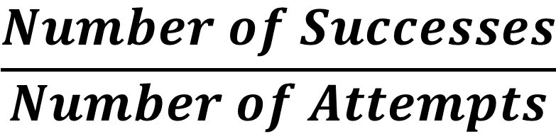
Logistic Regression – Probability
$$\frac{Number of Successes}{Number of Attempts}$$
Introduction | Background | The Math | Examples | Conclusions

Slide 7
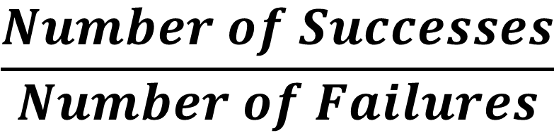
Logistic Regression – The Odds Ratio
$$\frac{Number of Successes}{Number of Failures}$$
Introduction | Background | The Math | Examples | Conclusions

Slide 8

Logistic Regression – The Odds Ratio
$$\frac{Number of Successes}{Number of Failures}= \frac{2}{3}$$
Introduction | Background | The Math | Examples | Conclusions

Slide 9

Logistic Regression – The Odds Ratio
$$\frac{Number of Successes}{Number of Failures}= \frac{2}{3}=Odds Ratio$$
Introduction | Background | The Math | Examples | Conclusions

Slide 10
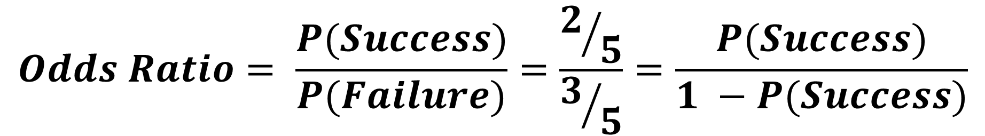
Logistic Regression – The Odds Ratio
$$Odds Ratio= \frac{P(Success)}{P(Failure)}=\frac{2/5}{3/5}=\frac{P(Success)}{1 −P(Success)}$$
Introduction | Background | The Math | Examples | Conclusions

Slide 11
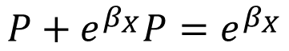
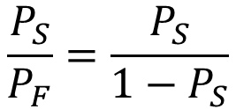
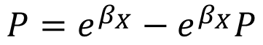
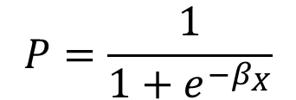
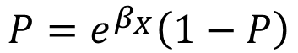
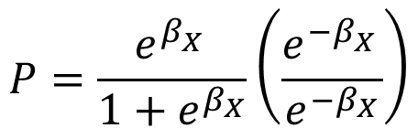
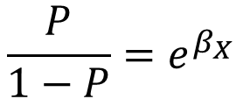
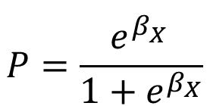
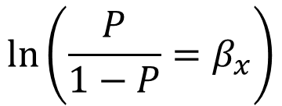
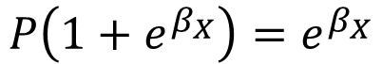
Logistic Regression – The Math Behind
$$\frac{P_{S}}{P_{F}}=\frac{P_{S}}{1−P_{S}}$$
$$P=\frac{e^{β_{X}^{}}}{1+e^{β_{X}}}$$
$$P=e^{β_{X}}−e^{β_{X}}P$$
$$ln⁡\left(\frac{P}{1−P}=β_{x}\right)$$
$$P=\frac{e^{β_{X}^{}}}{1+e^{β_{X}}}\left(\frac{e^{{−β}_{X}^{}}}{e^{{−β}_{X}}}\right)$$
$$P+e^{β_{X}}P=e^{β_{X}}$$
$$\frac{P}{1−P}=e^{β_{X}}$$
$$P=\frac{1}{1+e^{{−β}_{X}}}$$
$$P\left(1+e^{β_{X}}\right)=e^{β_{X}}$$
$$P=e^{β_{X}}\left(1−P\right)$$
Introduction | Background | The Math | Examples | Conclusions

Slide 12

Logistic Regression – The Model
$$P=\frac{1}{1+e^{−βx}}$$
Introduction | Background | The Math | Examples | Conclusions

Slide 13
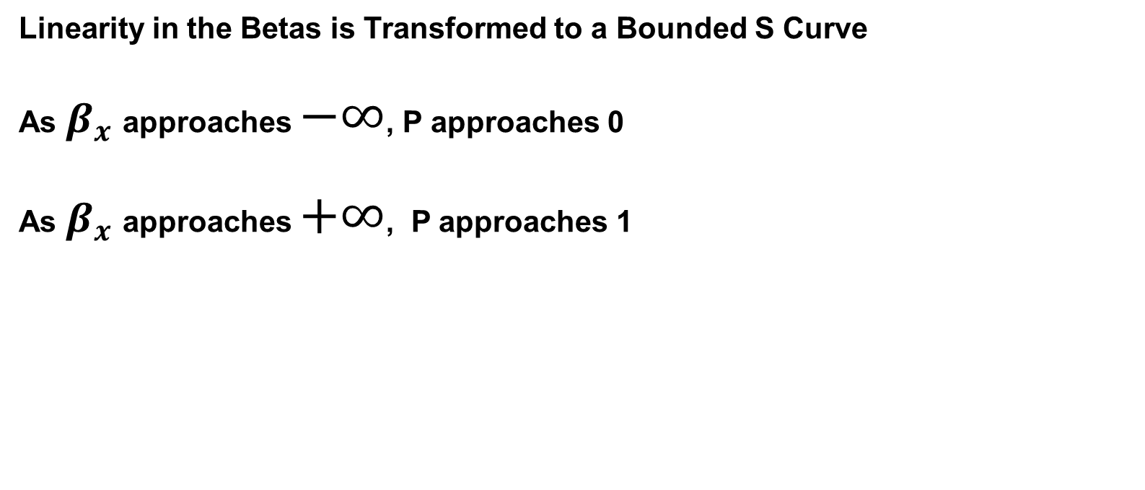
Logistic Regression
Linearity in the Betas is Transformed to a Bounded S Curve
As $β_{x}$approaches $−∞$, P approaches 0
As $β_{x}$approaches $+∞$, P approaches 1
Introduction | Background | The Math | Examples | Conclusions

Slide 14

Gavin’s Locations
Grandma’s Pond
Uncle Ron’s Canal
Introduction | Background | The Math | Examples | Conclusions

Slide 15
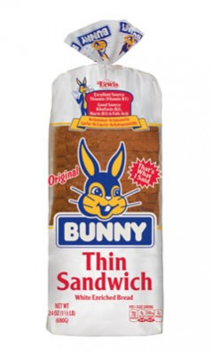

Gavin’s Bait
Bread
Hot Dogs
Introduction | Background | The Math | Examples | Conclusions

Slide 16
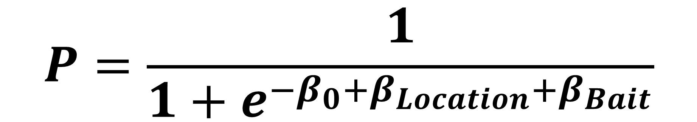
Logistic Regression – Exponentiation
$$P=\frac{1}{1+e^{−β_{0}+β_{Location}+β_{Bait}}}$$
Binary Variables
Introduction | Background | The Math | Examples | Conclusions

Slide 17
Modeling Gavin’s Fishing
Model 0: Intercept Only, No Independent Variables (For Comparison)
Model 1: Place Variable Only
Model 2: Bait Variable Only
Model 3: Place and Bait Variables (Full Logistic Model)
Introduction | Background | The Math | Examples | Conclusions

Slide 18
Gavin’s Data
rm(list=ls())
library(readxl)
gavin=read_excel("6304 Module 8 Data Sets.xlsx",sheet="Gavin Fishing")
colnames(gavin)=tolower(make.names(colnames(gavin)))
attach(gavin)
Introduction | Background | The Math | Examples | Conclusions

Slide 19
Parameterizing the Models in R
output0=glm(success~1,data=gavin,family=binomial)
output1=glm(success~place,data=gavin,family=binomial)
output2=glm(success~bait,data=gavin,family=binomial)
output3=glm(success~place+bait,data=gavin,family=binomial)
Introduction | Background | The Math | Examples | Conclusions

Slide 20
Model Summary (Model 3)
Call:
glm(formula = success ~ place + bait, family = binomial, data = gavin)
Deviance Residuals:
Min 1Q Median 3Q Max
-2.3957 -0.5320 0.3417 0.8982 1.0823
Coefficients:
Estimate Std. Error z value Pr(>|z|)
(Intercept) 0.2279 0.7775 0.293 0.7695
placeUncle Ron's Canal -2.1118 1.2292 -1.718 0.0858 .
baitHot Dogs 2.5834 1.2486 2.069 0.0385 *
---
Signif. codes: 0 ‘***’ 0.001 ‘**’ 0.01 ‘*’ 0.05 ‘.’ 0.1 ‘ ’ 1
(Dispersion parameter for binomial family taken to be 1)
Null deviance: 29.767 on 21 degrees of freedom
Residual deviance: 21.110 on 19 degrees of freedom
AIC: 27.11
Number of Fisher Scoring iterations: 5
Introduction | Background | The Math | Examples | Conclusions

Slide 21
Model Summary (Model 3)
Call:
glm(formula = success ~ place + bait, family = binomial, data = gavin)
Deviance Residuals:
Min 1Q Median 3Q Max
-2.3957 -0.5320 0.3417 0.8982 1.0823
Coefficients:
Estimate Std. Error z value Pr(>|z|)
(Intercept) 0.2279 0.7775 0.293 0.7695
placeUncle Ron's Canal -2.1118 1.2292 -1.718 0.0858 .
baitHot Dogs 2.5834 1.2486 2.069 0.0385 *
---
Signif. codes: 0 ‘***’ 0.001 ‘**’ 0.01 ‘*’ 0.05 ‘.’ 0.1 ‘ ’ 1
(Dispersion parameter for binomial family taken to be 1)
Null deviance: 29.767 on 21 degrees of freedom
Residual deviance: 21.110 on 19 degrees of freedom
AIC: 27.11
Number of Fisher Scoring iterations: 5
Your Model (In Case You Forgot)
Introduction | Background | The Math | Examples | Conclusions

Slide 22
Model Summary (Model 3)
Call:
glm(formula = success ~ place + bait, family = binomial, data = gavin)
Deviance Residuals:
Min 1Q Median 3Q Max
-2.3957 -0.5320 0.3417 0.8982 1.0823
Coefficients:
Estimate Std. Error z value Pr(>|z|)
(Intercept) 0.2279 0.7775 0.293 0.7695
placeUncle Ron's Canal -2.1118 1.2292 -1.718 0.0858 .
baitHot Dogs 2.5834 1.2486 2.069 0.0385 *
---
Signif. codes: 0 ‘***’ 0.001 ‘**’ 0.01 ‘*’ 0.05 ‘.’ 0.1 ‘ ’ 1
(Dispersion parameter for binomial family taken to be 1)
Null deviance: 29.767 on 21 degrees of freedom
Residual deviance: 21.110 on 19 degrees of freedom
AIC: 27.11
Number of Fisher Scoring iterations: 5
Beta Coefficients
Introduction | Background | The Math | Examples | Conclusions

Slide 23
Model Summary (Model 3)
Call:
glm(formula = success ~ place + bait, family = binomial, data = gavin)
Deviance Residuals:
Min 1Q Median 3Q Max
-2.3957 -0.5320 0.3417 0.8982 1.0823
Coefficients:
Estimate Std. Error z value Pr(>|z|)
(Intercept) 0.2279 0.7775 0.293 0.7695
placeUncle Ron's Canal -2.1118 1.2292 -1.718 0.0858 .
baitHot Dogs 2.5834 1.2486 2.069 0.0385 *
---
Signif. codes: 0 ‘***’ 0.001 ‘**’ 0.01 ‘*’ 0.05 ‘.’ 0.1 ‘ ’ 1
(Dispersion parameter for binomial family taken to be 1)
Null deviance: 29.767 on 21 degrees of freedom
Residual deviance: 21.110 on 19 degrees of freedom
AIC: 27.11
Number of Fisher Scoring iterations: 5
p Values
Introduction | Background | The Math | Examples | Conclusions

Slide 24
Model Summary (Model 3)
Call:
glm(formula = success ~ place + bait, family = binomial, data = gavin)
Deviance Residuals:
Min 1Q Median 3Q Max
-2.3957 -0.5320 0.3417 0.8982 1.0823
Coefficients:
Estimate Std. Error z value Pr(>|z|)
(Intercept) 0.2279 0.7775 0.293 0.7695
placeUncle Ron's Canal -2.1118 1.2292 -1.718 0.0858 .
baitHot Dogs 2.5834 1.2486 2.069 0.0385 *
---
Signif. codes: 0 ‘***’ 0.001 ‘**’ 0.01 ‘*’ 0.05 ‘.’ 0.1 ‘ ’ 1
(Dispersion parameter for binomial family taken to be 1)
Null deviance: 29.767 on 21 degrees of freedom
Residual deviance: 21.110 on 19 degrees of freedom
AIC: 27.11
Number of Fisher Scoring iterations: 5
Deviance Factors
Null: No X Variables
Residual: This Model
Introduction | Background | The Math | Examples | Conclusions

Slide 25
Extracting Coefficients and Confidence Intervals
coef(output3)
confint(output3)
Introduction | Background | The Math | Examples | Conclusions

Slide 26
Create and View An Output Object
gavin.coefficients=cbind("Beta Coef"=coef(output3),confint(output3))
gavin.coefficients
Introduction | Background | The Math | Examples | Conclusions

Slide 27
Creates an Object of All X Variable Levels
gavin.predictions=expand.grid(bait=unique(gavin$bait),place=unique(gavin$place))
Introduction | Background | The Math | Examples | Conclusions

Slide 28
Calculates Predictions for X Variable Levels
gavin.predictions$pred_prob=predict(output3,newdata=gavin.predictions,type="response")
gavin.predictions
Introduction | Background | The Math | Examples | Conclusions

Slide 29
Calculates Predictions for X Variable Levels
bait place pred_prob
1 Bread Grandma's Pond 0.5567196
2 Hot Dogs Grandma's Pond 0.9432804
3 Bread Uncle Ron's Canal 0.1319365
4 Hot Dogs Uncle Ron's Canal 0.6680635
Introduction | Background | The Math | Examples | Conclusions

Slide 30


Gavin’s Predictions
 | .5567 | .1319
 | .9433 | .6681
Introduction | Background | The Math | Examples | Conclusions

Slide 31
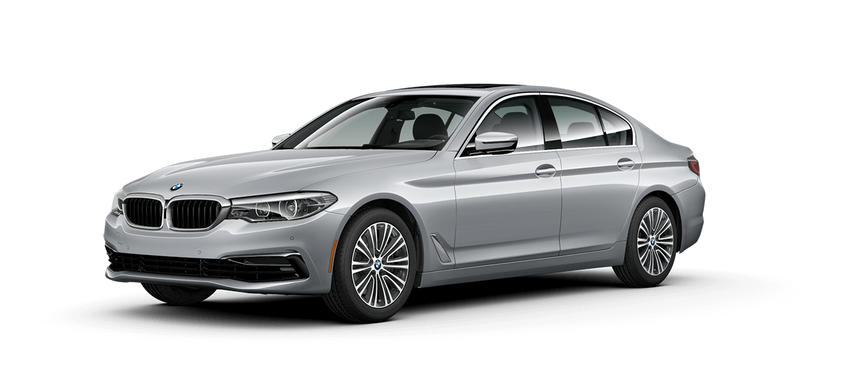
Logistic Regression – BMW Purchase
Introduction | Background | The Math | Examples | Conclusions

Slide 32
Logistic Regression – BMW Purchase
rm(list=ls())
bmw=read_excel("6304 Module 8 Data Sets.xlsx", sheet = "BMW", skip=2)
colnames(bmw)=tolower(make.names(colnames(bmw)))
attach(bmw)
Introduction | Background | The Math | Examples | Conclusions

Slide 33
Logistic Regression – BMW Purchase
plot(income,purchase,pch=19,main="Plot of BMW Data")
Introduction | Background | The Math | Examples | Conclusions

Slide 34
Logistic Regression – BMW Purchase
bmw.out=glm(purchase~income,family="binomial",data=bmw)
summary(bmw.out)
Introduction | Background | The Math | Examples | Conclusions

Slide 35
Logistic Regression – BMW Purchase
beta.info=cbind("beta"=coef(bmw.out),confint(bmw.out))
beta.info
Introduction | Background | The Math | Examples | Conclusions

Slide 36
Logistic Regression – BMW Purchase
pred.info=expand.grid(income=seq(min(bmw$income),max(bmw$income), by=1000))
Introduction | Background | The Math | Examples | Conclusions

Slide 37
Logistic Regression – BMW Purchase
pred.info$pred.beta=predict(bmw.out,newdata=pred.info,type="link")
pred.info$pred.prob=plogis(pred.info$pred.beta)
Introduction | Background | The Math | Examples | Conclusions

Slide 38
Logistic Regression – BMW Purchase
plot(income,purchase,pch=19,main="Plot of BMW Data")
points(pred.info$income,pred.info$pred.prob,col="red",pch=19)
Introduction | Background | The Math | Examples | Conclusions

Slide 39

Logistic Regression – Childhood Myopia
Introduction | Background | The Math | Examples | Conclusions

Slide 40
Logistic Regression – Childhood Myopia
rm(list=ls())
myopia=read_excel("6304 Module 8 Data Sets.xlsx",sheet="Myopia",skip=2)
colnames(myopia)=tolower(make.names(colnames(myopia)))
attach(myopia)
Introduction | Background | The Math | Examples | Conclusions

Slide 41
Logistic Regression – Childhood Myopia
myopia.out=glm(myopic~age+gender+mommy+dadmy+tvhr,data=myopia)
summary(myopia.out)
Introduction | Background | The Math | Examples | Conclusions

Slide 42
Logistic Regression – Childhood Myopia
beta.info=cbind("beta"=coef(myopia.out),confint(myopia.out))
beta.info
Introduction | Background | The Math | Examples | Conclusions

Slide 43
Logistic Regression – Childhood Myopia
pred.info=expand.grid(age=c(5,6,7,8,9),gender=unique(myopia$gender),
mommy=unique(myopia$mommy),dadmy=unique(myopia$dadmy),
tvhr=quantile(myopia$tvhr,c(.2,.4,.6,.8)))
Introduction | Background | The Math | Examples | Conclusions

Slide 44
Logistic Regression – Childhood Myopia
pred.info$pred.beta=predict(myopia.out,newdata=pred.info,type="link")
pred.info$pred.prob=plogis(pred.info$pred.beta)
Introduction | Background | The Math | Examples | Conclusions

Slide 45
What Have We Covered?
Logistic Regression Reasons/Rationale
The Math Behind
Examples and Interpretations
Introduction | Background | The Math | Examples | Conclusions

